Slide 1

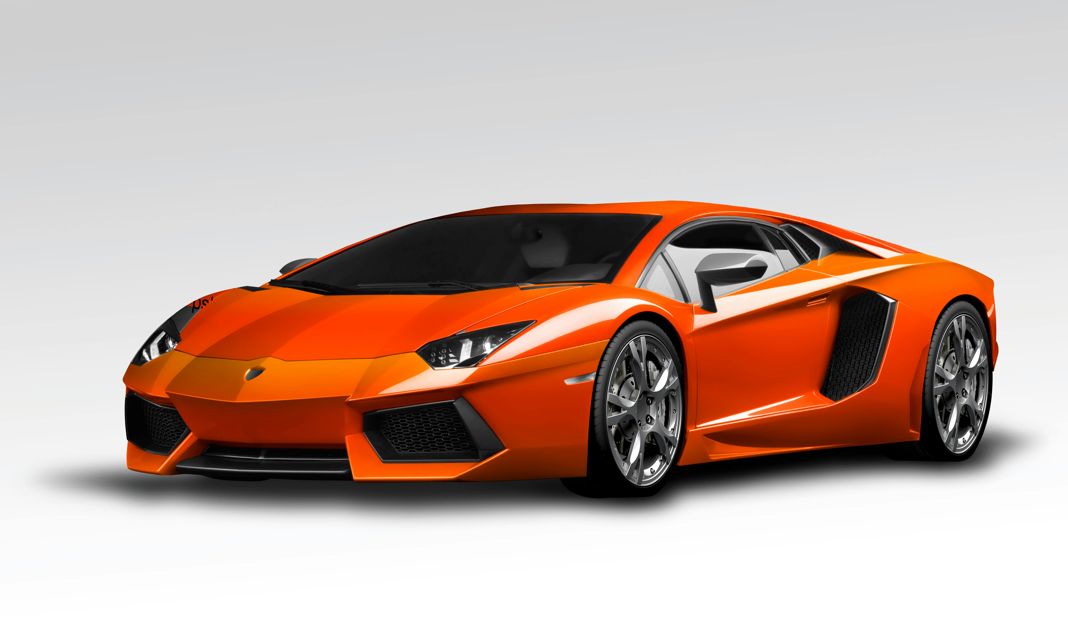
Your computer!
Showing nothing
server computer!
Having picture of car
You: show me a car
Application
Application
Transport
Transport
Internet link loop happens about 15 times (showing only 2 times for example)
Internet
Internet
Internet
Internet
Link
Link
Link
Link
Ethernet
Fiber,
Satellite
Etc.
Ethernet

Slide 2
Your computer!
Showing nothing
server computer!
Having picture of car
You: show me a car
Application
Application
Transport
Transport
Internet link loop happens about 15 times (showing only 2 times for example)
Internet
Internet
Internet
Internet
Link
Link
Link
Link
Ethernet
Fiber,
Satellite
Etc.
Ethernet

